Slide 1
IP Issues in the Era of Artificial Intelligence
Prof. Joseph Straus, Munich
3rd EU China IP Academic Forum
Shanghai, November 22, 2018

Slide 2
Points to Consider
The Fourth Industrial Revolution
Artificial Intelligence (AI) – Evolutionary Technology
Investments in AI Technologies
AI "Products"
AI – Challenges for standard patent law concepts
Lessons to Learn

Slide 3
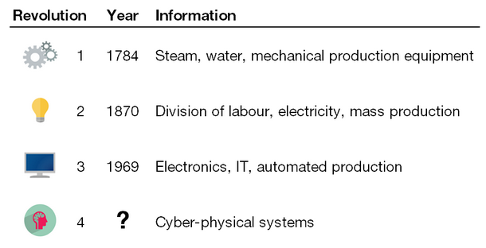
Navigating the Next Industrial Revolution
Source: World Economic Forum

Slide 4
The Fourth Industrial Revolution
The advent of cyber-physical systems – involving entirely new capabilities for people and machines
[N. Davis, WEF, ]
The marriage of physical and advanced digital technologies, such as
analytics, artificial intelligence, cloud computing and the internet of things
[Forbes Insights with Deloitte]

Slide 5
Artificial Intelligence (AI)
"The science and engineering of making intelligent machines"
[John McCarthy, 1955]
A machine's adaptation of cognitive functions that are associated with the human mind – such as understanding of language, problem solving, and learning
[https://www.techpats.com/artificial-intelligence-potential-implications-patents/]
In the sense of patent law: Mathematical algorithms allowing computers to simulate intelligent human behavior
European Patent Office

Slide 6
Artificial Narrow Intelligence (ANI)
Specialized in a specific area – e.g. IBM's Deep Blue® Super Computer (Chess), or China's Tianhe-II – 34 quadrillion calculations per second!
Can solve complex problems extremely fast – but have no perception of things other than the information provided to them by the creators
Examples: Intelligent thermometers (Nest®), Apple's "Sirr"®, video games, search engines, etc.
Cannot imitate thought process outside the scope of their pre-determined operation
Efforts on the way on creating an AI processing information with software based on human physical, biological and chemical thought process; electronic neural networks, cognitive computing algorithm and artificial neo-cortex through software.
[Gurkaynak, Yilmaz, Haksever, 2016]

Slide 7
Artificial General Intelligence (AGI)
Represents "Human-level AIs", computers as smart as humans – in every aspect and capable of performing all intellectual tasks humans can
Performing tasks involving complex calculations requiring substantial effort, time dedication for humans – very simple for AIs
AI by now succeeded in doing essentially everything that requires "thinking" but has failed to do most of what people and animals do "without thinking"
May be reached around 2030
[Gurkaynak, Yilmaz, Haksever, 2016]

Slide 8
Artificial Super Intelligence (ASI)
Represents AIs "much smarter than the best human brains in practically every field, including scientific creativity, general wisdom and social skills"
It is expected that AGI once established it will evolve itself into an ASI very quickly – as a result of an exponential growth (phenomenon of "intelligence explosion" or "singularity)
ASI major forms: speed super intelligence, collective super intelligence and quality super intelligence – anyone of the three capable of creating the other two
[Gurkaynak, Yilmaz, Haksever, 2016]

Slide 9
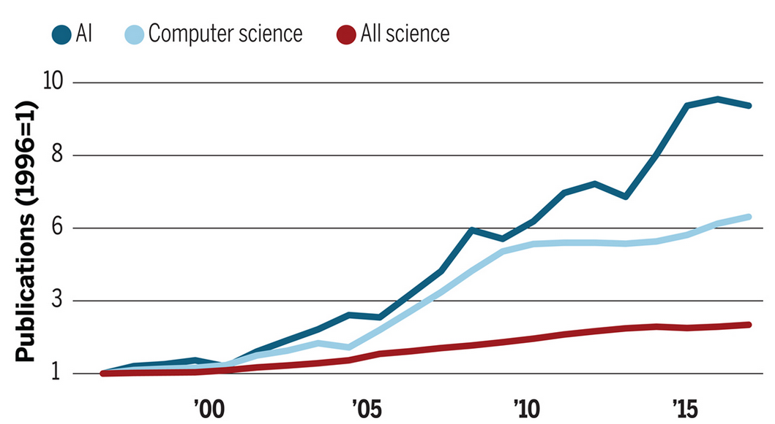
Artificial Intelligence Explosion
Hutson, Science 18 May 2008

Slide 10
Some Technical Foundation of AI
Tools that can process vast amounts of data, detect and interpret patterns – previously impossible to calculate, identify or even imagine
They enable machine prediction, diagnoses, modeling and risk analysis
AI – an essential element enabling effective use of large data volumes – not manageable manually – and algorithms no longer efficiently reprogrammed by hand

Slide 11
Machine Learning – An Important AI Tool
A method of data analysis that automates analytical model building
Uses algorithms that iteratively learn from data
Allows computer to find hidden insights without being explicitly programmed where to look
Google's "AlphaGo" – masters Go – "Deep learning is killing every problem in AI"
[J. Schaefer, 2016]

Slide 12
Investments in AI Technologies
China – US $ 2.1 billion on an AI industrial park
EU - € 1.5 billion to AI research through 2020
France - € 1.5 billion to AI research through 2022
US Government – hesitant to engage

Slide 13
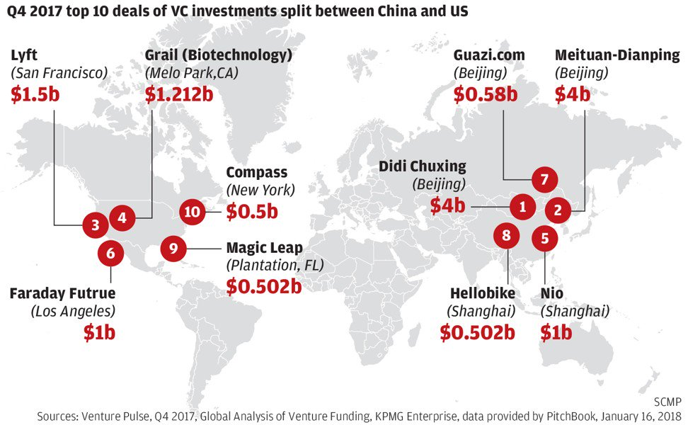
Q4 2017 TOP 10 Deals of VC Investments Split Between China and US in AI

Slide 14
Comparison United States - China
 | United States | China
Years experience of the nation’s data scientists | More than half have more than 10 years. | Forty percent have less than 5 years.
AI patent applications, 2010–2014 | 15,317 (First in world) | 8410 (Second)
Number of workers in AI positions | 850,000 (First) | 50,000 (Seventh)
Percent of private AI investment (2016) | 66% (First) | 17% (Second)
[Data: Astamuse; Linkedin; Mckinsey Global Institute]

Slide 15
Comparison United States - China
"For traditional scientific fields, Chinese [scientists] have a long way to go to compete with the U.S. or Europe. But for computer science, it's a relatively new thing. Young people can compete. Chinese can compete."
"China played no role in launching the AI revolution, but is making breathtaking progress catching up."
[Eric Lander, President of the Broad Institute in Cambridge, Mass.]

Slide 16
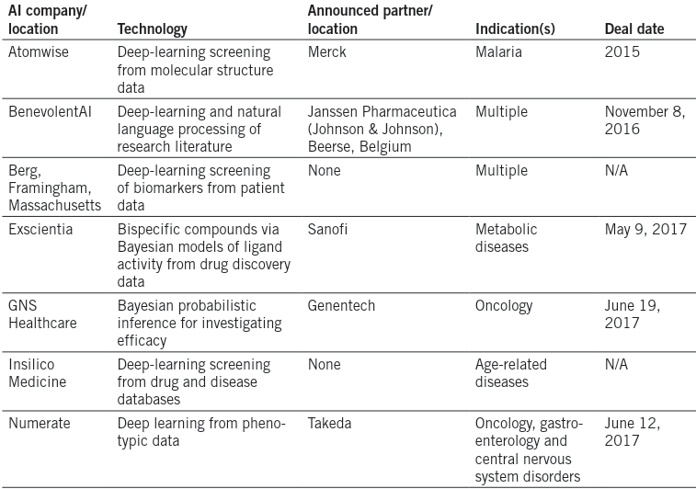
AI-Powered Drug Discovery Captures Pharma Interest
Source: Nature Biotechnology, Vol. 35, No. 7, July 2017

Slide 17
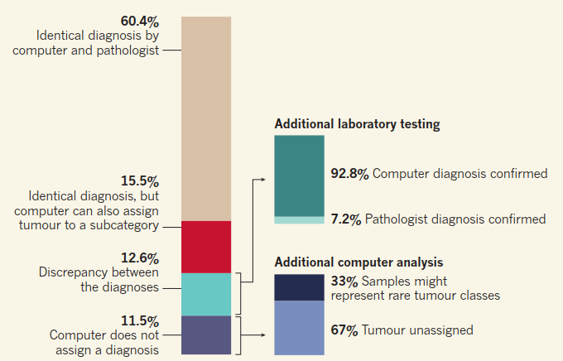
Machine Learning Classifies Cancer
Tumour classification using a machine-learning approach. Capper et al.1 used a machine-learning approach to classify brain tumours on the basis of genome-wide patterns of a type of DNA alteration called methylation. The computer was trained using methylation data for tumour samples that had been diagnosed by pathologists using standard microscopy-based analysis or analysis of selected genes. After training, the computer was given 1,104 test cases. The authors compared the diagnoses made by the computer and by the pathologists. Although the machine was unable to diagnose all specimens, of the specimens that it classified, the machine-based diagnosis was more accurate or could assign tumours to more-specific subcategories than the classifications made by the pathologists.
Source: Nature, 22 March 2018

Slide 18
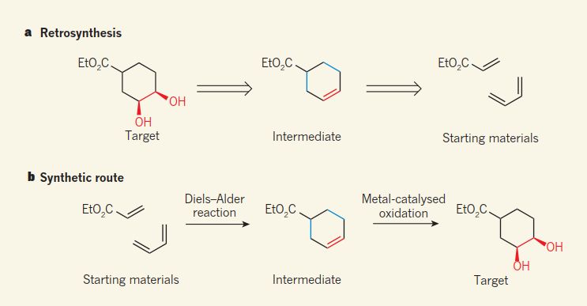
AI Designs Organic Synthesis - A System in Which an AI Program Learns the Rules for Itself -
Retrosynthetic Analysis
Source: Nature, 29 March 2018

Slide 19
Multibillion Investments in AI & Resulting Products and Processes - Require Efficient Patent Protection – Patent Eligible
EPO, JPO, SIPO & USPTO – by and large – apply same standards as for "traditional" computer implemented inventions
Patents available for inventions where computer programs [i.e. algorithm-related inventions] make a technical contribution, e.g. in the fields of:
medical devices; the automotive sector; industrial control; communication/media technology; automated natural language translation; voice recognition and video compression; computers/processes itself

Slide 20
US Patent No. US 8,126,832 B2 of February 28, 2012 for "Artificial Intelligence System" of Cognitive Code Corp.
"The present invention extracts concepts from text and/or speech and utilizes numeric representations of concepts and their relationships. The extraction of concepts allows expression in various patterns to be understood by the system. The processes allow the system to bypass human language constraints in order to think in concepts. The present system may also dynamically construct output so that it can generate intelligent responses in a number of grammatically correct ways. Because the system utilizes numeric representations of concepts and their relationships, the system is language independent and may even function with a plurality of languages."

Slide 21
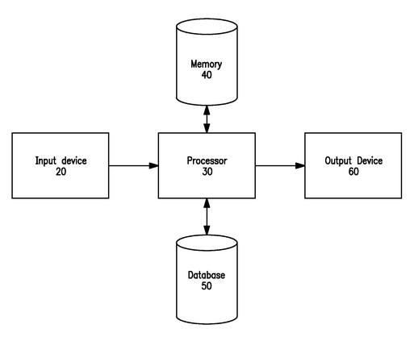
US Patent No. US 8,126,832 B2 of February 28, 2012 for "Artificial Intelligence System" of Cognitive Code Corp.

Slide 22
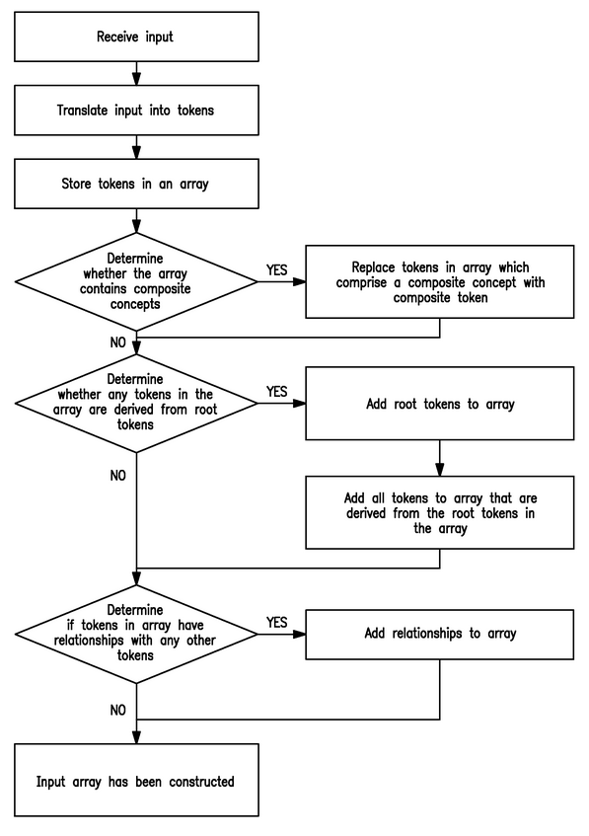
US Patent No. US 8,126,832 B2 of February 28, 2012 for "Artificial Intelligence System" of Cognitive Code Corp.

Slide 23
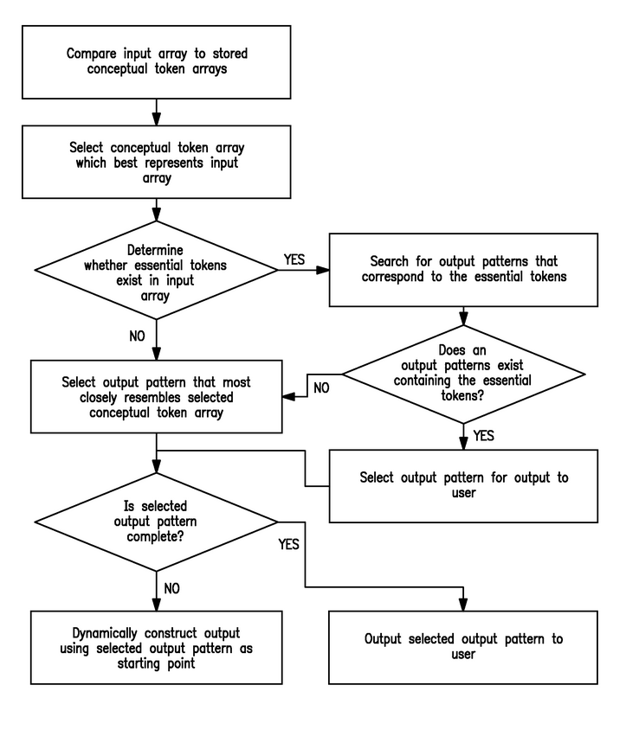
US Patent No. US 8,126,832 B2 of February 28, 2012 for "Artificial Intelligence System" of Cognitive Code Corp.

Slide 24
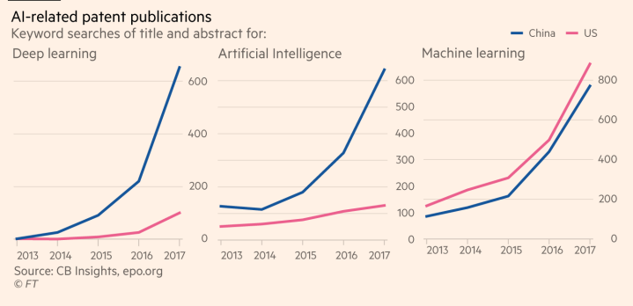
AI-Related Patent Publications

Slide 25
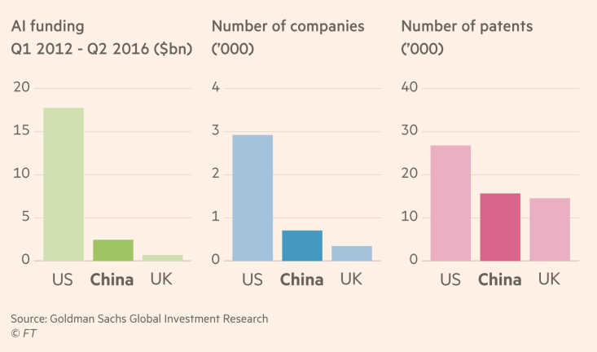
China is Catching Up With the US in AI

Slide 26
Development of Families with Applications in AI
Source: EPO

Slide 27
US-AI Patent Champions
IBM: 2012-2017 – 5.600 AI patents (in 2017 more than 1.400)
IBM's Watson - a cloud based AI product – provides Application Program Interfaces (APIs) that can understand all forms of data to reveal business critical insights "harnessing" the power of cognitive computing – organized into various products for building cognitive search
Google: 2012-2017 - ~ 4.500 AI patents
Google's neural machine translation system developed its own internal language to represent the concepts it uses to translate other languages

Slide 28
AI Challenges of Traditional Patent Law Concepts
Currently applied approaches overlook/ignore [?] that AI technology itself creates its own technology & applications, i.e. inventions – solutions of technical problems with technical means
This requires, inter alia, new assessments of:
the notion "invention" [identifying a problem, then solved by AI?]
[non]patentability of mathematical algorithms – the "self-evolving" core of AI
who is the inventor – can a legal person be an inventor?
the notion of the “person” skilled in the art – decisive for assessing inventive step

Slide 29
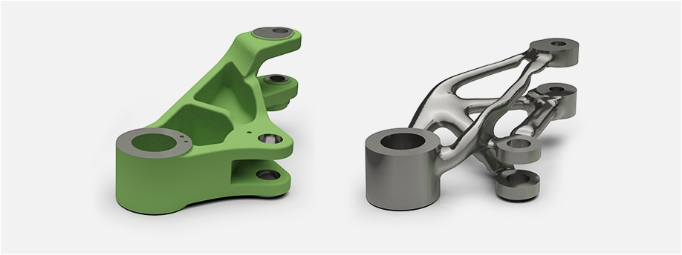
Challenges for the IP System Digital Inventor?
Source: Siemens AG 2018

Slide 30
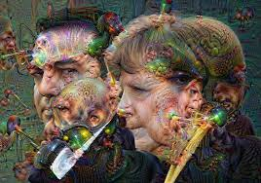
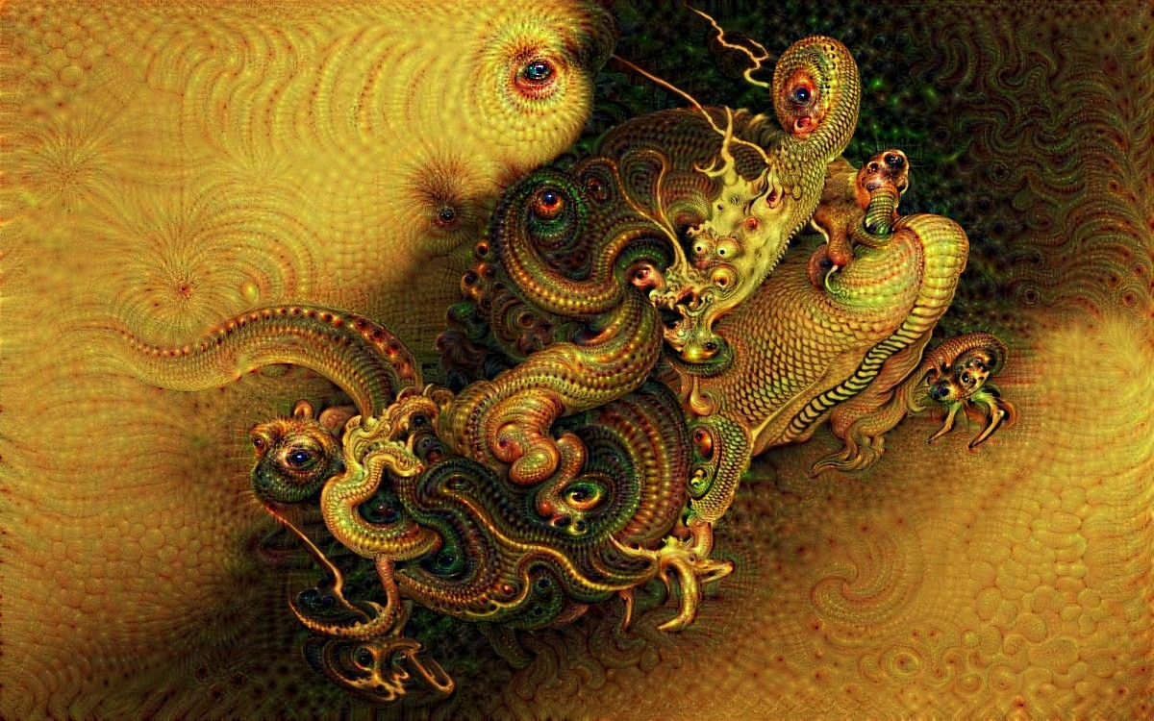
Deep Dream Image Example
Works of Art?

Slide 31
Inventorship in the context of AI
Does the inventor have to be a natural person?
Although not explicitly mentioned in EPC, the inventor can only be a natural person according to the current legal interpretation (Articles 60, 62 and 81 EPC)
The inventor is the one who is the author of the claimed invention, i.e. who has recognised the idea of the invention and has developed it into a technical instruction in creative activity. Only a human being is capable of a creative activity in this sense. (Benkard EPÜ, 2. edition, Article 60, points 9-10)
Source: EPO

Slide 32
Inventions generated by AI
In the context of machine inventions, various levels of human participations are possible
Although the technical solution can be developed to a large extent by a machine, the human being is currently not completely eliminated from the process
The human being triggering the process of inventing through creative ideas and/or combining the results delivered by a machine remains the inventor
Source: EPO

Slide 33
Could AI be designated as inventor?
Current situation
if the applicant designates AI (e.g. a computer) as the inventor, the requirements of Article 81 and Rule 19 EPC are not met
if no valid designation of the inventor is filed, the application will be refused (Article 90(5) EPC)
Source: EPO

Slide 34
Designation of AI as inventor
Should inventions be generated solely by AI, it could become necessary to clarify whether AI could be considered as the inventor
The role of the inventor and the interpretation of the term inventor would have to be adapted
Also the right to a patent in the sense of Article 60(1) EPC would have to be clarified by the legislator
Source: EPO

Slide 35
Effect of AI on the skilled person
If the use of particular creative software becomes common in a certain field of technology, it may be presumed that the skilled person would use such software
Inventions involving AI or machine learning may therefore raise the skills and knowledge of the skilled person
This would have an impact on the afore-mentioned requirements of disclosure and inventive step
Source: EPO

Slide 36
The UK/Irish Copyright Solution – A Viable Model?
The copyright in "works generated by a computer in circumstances such that there is no human author"
Vested in "the person by whom the arrangement necessary for the creation of the work are undertaken"
[Copyright, Designs and Patents Act, 1988, c48, § 178 (UK)
Copyright and Related Rights Act, 2000, part 5, § 2 Art. No. 28/2000 (IV)]
Computer-generated works – not the works of an AI
Is "non-human" copyright ownership possible? If so – to whom it should belong?

Slide 37
Lessons to Learn
Over centuries the IP-system – by adapting itself to ever evolving challenges of technological and scientific developments – also those of the 1st, 2nd and 3rd industrial revolution – have served the public's well-being well
The IP-system should develop further – to meet the needs of the 4th industrial revolution in general and that of AI specifically – internationally harmonized & rational & consistent approach necessary!!
Those challenges may/will have an entirely new quality – thereby the evolving AI technology will help humans in solving problems beyond known paradigms

Slide 38
Thank you
for your attention!
谢谢大家听我的发言！
Notes:
Thank you for listning to my presentation!
38

